Slide 1
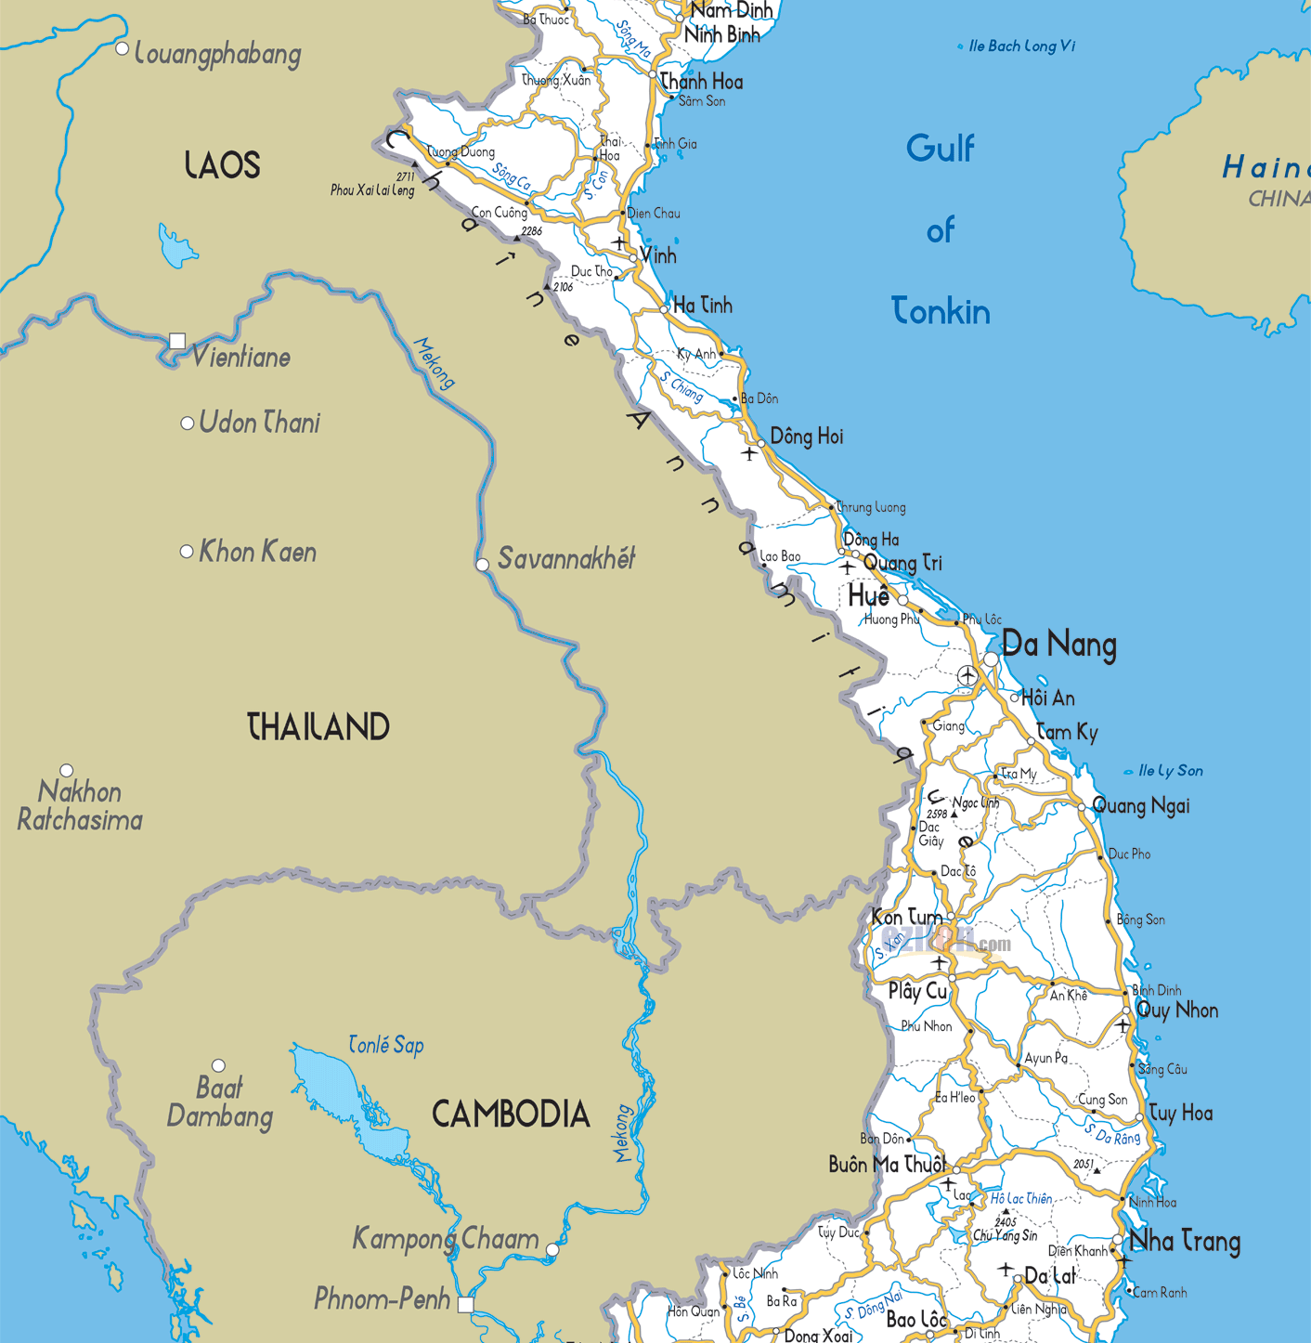

My parents are from Hue and my mom is from North somewhere

Slide 2
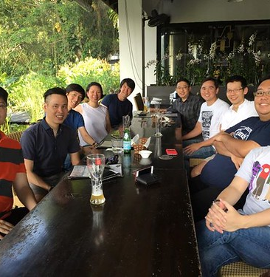
What we do for fun
We dont really do anything for fun but we just hang out and do our own thing.
Not my family.

Slide 3
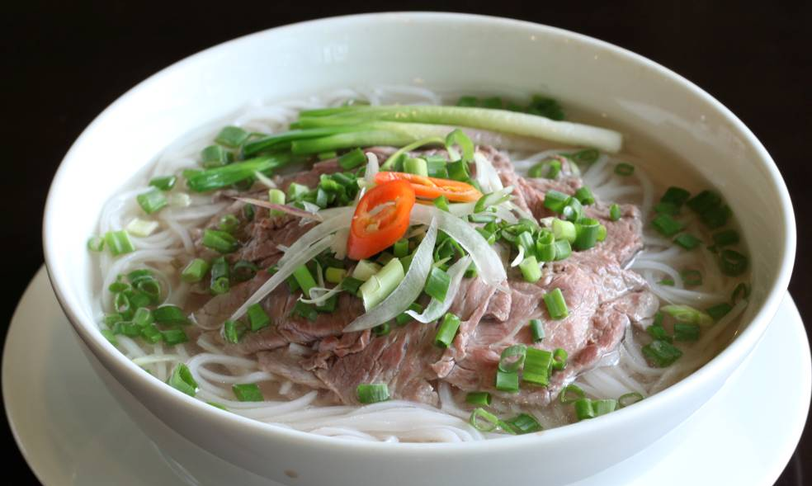
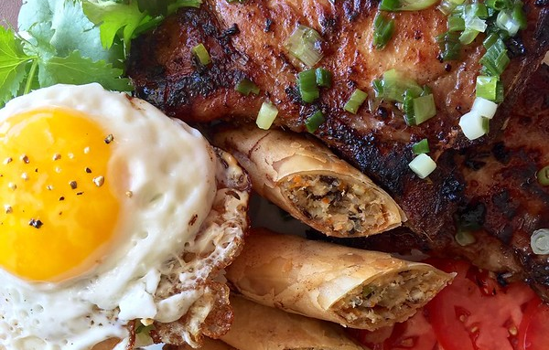
Foods
Phở, Sườn Nướng, Egg rolls
This Photo by Unknown author is licensed under CC BY-NC-ND.
This Photo by Unknown author is licensed under CC BY-ND.

Slide 4
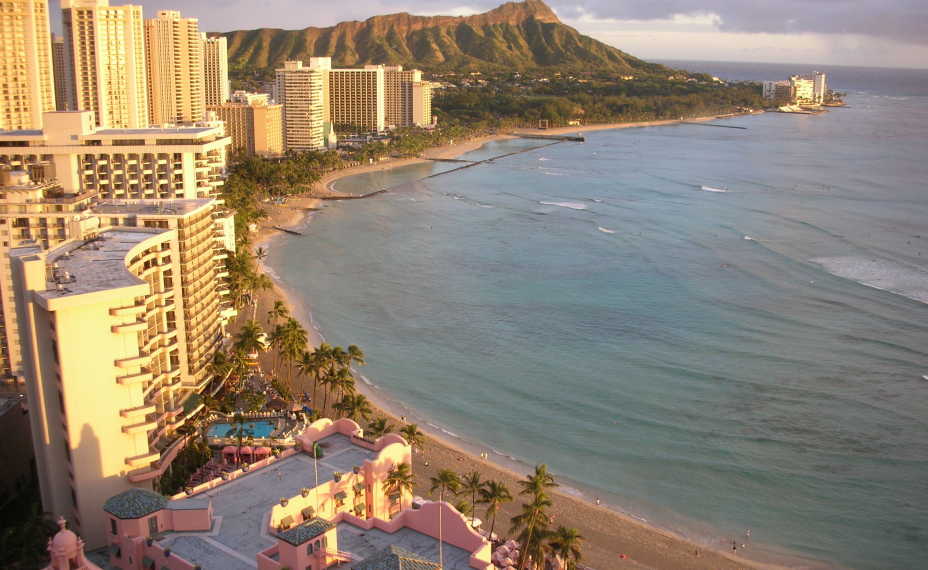
Vacations
Hawaii, Florida
This Photo by Unknown author is licensed under CC BY-SA.

Slide 5
Music
Everything under the sun that isn't country. Most recently been listening to A lot of asian artists.
https://open.spotify.com/track/3olqy6cgUoqV4zjLEeBXSl?si=fb7554fdc7e047c1
https://open.spotify.com/playlist/7Bx0t6bxmcR4GEBX2v1zGM?si=07f0f9c037964591
Has all of the music that I've ever listened to

Slide 6
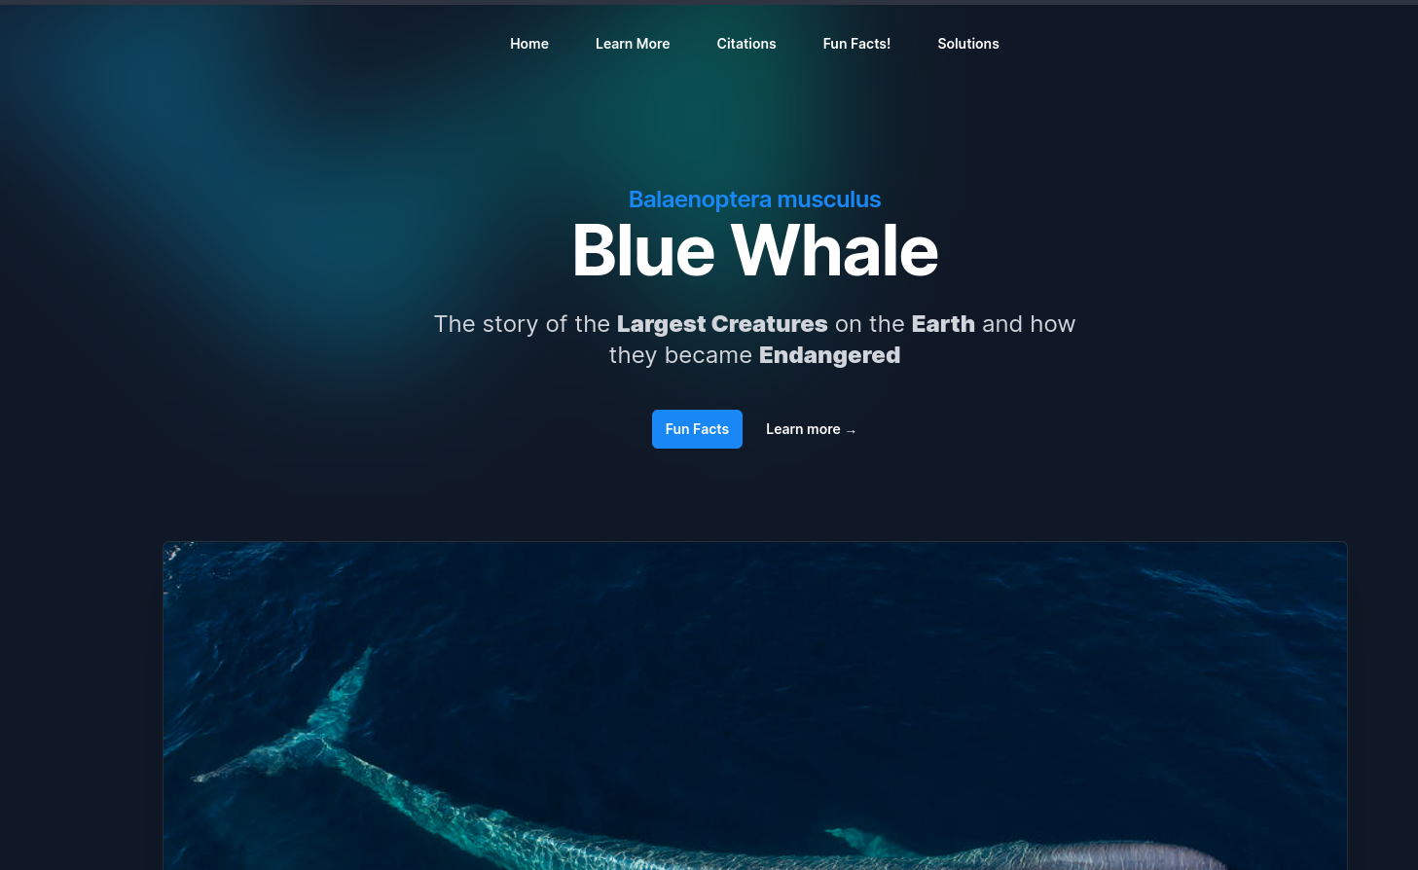
Interest
Programming

